Slide 1




Welcome to Code Crunch!
C8|Crunch Labs: Web Dev
THU 3-4PM Weekly | Spring 2025
Attendance
Earn a Certificate of Completion by attending at least 70% of the workshops
linktr.ee/CODE.CRUNCH

Slide 2
Week #3
Understanding the Box Model and Building Responsive Layouts

Slide 3
Introduction to the Week’s Topic
Overview: Today’s lesson focuses on the CSS Box Model and Flexbox, two essential concepts for layout design in modern web development.
Real-World Relevance:
The CSS Box Model is fundamental for understanding how elements behave within their containers, including spacing and borders.
Flexbox allows for flexible, responsive layouts without complex CSS rules.
Example: Show two examples of the same webpage layout: one with traditional floats and the other using Flexbox, highlighting the ease and responsiveness of Flexbox.

Slide 4
Key Concepts for Today’s Lecture
Concepts Covered:
CSS Box Model: Understanding margins, padding, borders, and content.
Flexbox Layout: Creating responsive layouts with Flexbox.
Using Flexbox for alignment and distribution of elements.

Slide 5
Introduction to the CSS Box Model
What is the Box Model?
The Box Model is a box that wraps around every HTML element, consisting of:
Content: The actual content of the box (text, images, etc.).
Padding: Space between the content and the border.
Border: The area surrounding the padding (optional).
Margin: The outermost space around the box, separating it from other elements.
Visual Representation: Show a diagram of a box model, illustrating content, padding, border, and margin.

Slide 6
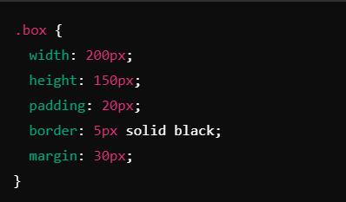

Slide 7
Box Model Details: Content, Padding, Border, Margin
Content: The area where the element’s content is displayed (e.g., text, images).
Padding: The space between the content and the element’s border. Padding increases the total size of the box.
Border: A border wraps the padding, and its width adds to the total size of the box.
Margin: The outermost space around the box, used to create space between elements.

Slide 8
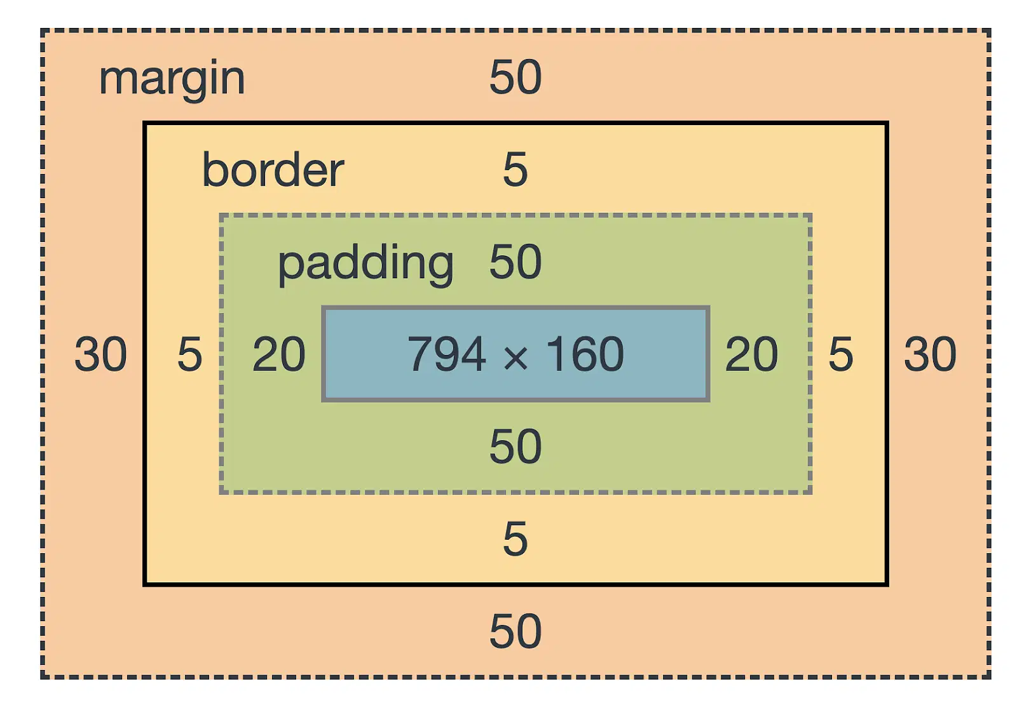
Box Model

Slide 9
Understanding Box-Sizing
Default Box-Sizing: The default box-sizing: content-box includes only the content width in the element’s size, which can lead to unexpected layouts.
Using box-sizing: border-box: This ensures that padding and border are included in the total width and height.

Slide 10
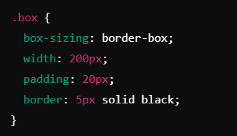

Slide 11
Introduction to Flexbox
What is Flexbox?
Flexbox is a one-dimensional layout model that allows you to distribute space within a container, making it easy to design complex layouts.
It provides an efficient way to align and distribute elements within a container, both horizontally and vertically, without the need for floats or positioning.
Core Concept:
Flexbox layouts are based on a flex container and flex items inside it.
Visual Example: Show how Flexbox works with simple horizontal and vertical alignment examples.

Slide 12
Flexbox Properties Overview
Container Properties:
display: flex: Defines the container as a flex container.
flex-direction: Defines the direction of flex items (row or column).
justify-content: Aligns items along the main axis (e.g., start, center, space-between).
align-items: Aligns items along the cross axis (e.g., start, center, stretch).
flex-wrap: Defines if items should wrap onto new lines.
Item Properties:
flex-grow: Defines how much a flex item should grow relative to other items.
flex-shrink: Defines how much a flex item should shrink relative to other items.
flex-basis: Defines the initial size of a flex item.
align-self: Allows individual items to override the align-items setting.

Slide 13
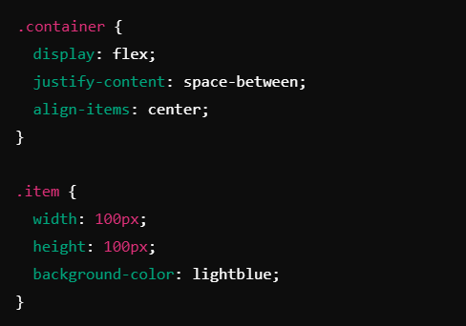
Flexbox Example: Creating a Simple Layout

Slide 14
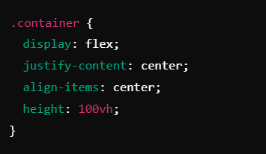
Creating a Centered Layout |
Align items both horizontally and vertically using justify-content and align-items.

Slide 15
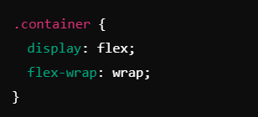
Wrapping Flex Items |
Allow items to wrap onto new lines if there isn’t enough space using

Slide 16
Summary of Key Points
CSS Box Model: Essential for understanding element dimensions and spacing.
Flexbox: Simplifies layout creation with flexible containers and responsive design features.
Takeaways:
Use box-sizing: border-box for easier layout management.
Flexbox properties like justify-content, align-items, and flex-wrap make creating responsive layouts simple and intuitive.

Slide 17
Coding Lab

Slide 18
Introduction to the Coding Lab
Objective: In this lab, students will apply Flexbox to create a responsive navigation bar and layout.
Skills Covered:
Applying Flexbox properties.
Building responsive layouts.
Creating a navigation bar with Flexbox.

Slide 19
Setting Up the Development Environment
Step 1: Open your project folder from Week 2.
Step 2: Create a new file named style.css and link it to your index.html file.

Slide 20
Task 1 - Creating the Navigation Bar

Slide 21
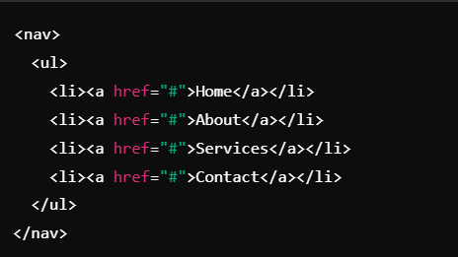
Create the HTML structure for the navbar

Slide 22
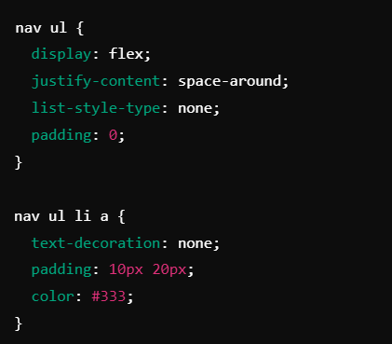
Apply Flexbox styles in style.css

Slide 23
Task 2 - Responsive Navigation Bar

Slide 24
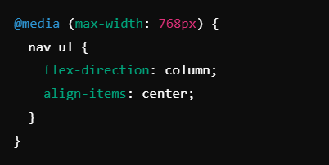
Step 1: Add a media query to change the navbar from a row to a column on small screens.

Slide 25
Task 3 - Creating a Responsive Layout

Slide 26
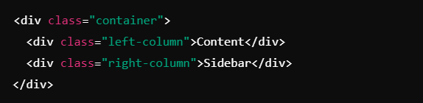
HTML structure for a basic two-column layout

Slide 27
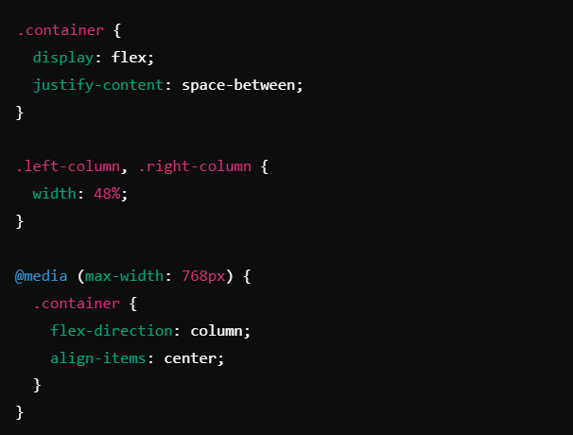
Apply Flexbox styles

Slide 28
Debugging and Troubleshooting
Common Issues:
Flexbox layout not displaying correctly due to missing display: flex.
Items not wrapping properly because flex-wrap is not used.
Solution: Use the browser’s Inspect tool to check the CSS styles applied to the elements and adjust accordingly.

Slide 29
Code Review
Walkthrough: Review the lab tasks done so far, ensuring all Flexbox properties are applied correctly and the layout is responsive.
Best Practices: Discuss clean code practices and efficiency in Flexbox usage.

Slide 30
Q & A Session

Slide 31

https://github.com/CODE-CRUNCH-CLUB/C8-CRUNCH-LABS-WEB-DEV

Slide 32





Attendance
Join us for the next sessions
Check our schedule on Discord “Schedule” Channel
RSVP lu.ma/CODECRUNCH
Your feedback helps us improve. Share your thoughts! Go to our website: go.fiu.edu/codecrunch
linktr.ee/CODE.CRUNCH

